Slide 1
SOUTHMOD bundle and its applications
2023 SOUTHMOD workshop, 5 September 2023, Oslo, Norway
Jesse Lastunen
Research Associate, UNU-WIDER
lastunen@wider.unu.edu

Slide 2
A reminder of the key motivation behind SOUTHMOD
Limited but expanding coverage of cash transfers
Rising need to finance social protection using domestic means rather than donor support
Urgent need to scale up such policies to create nationwide social protection systems
Need to improve domestic tax revenue mobilization
Need for reliable information and tools to help build up tax and social protection systems
→ Tax-benefit microsimulation models

Slide 3
SOUTHMOD project
13 national
teams
Collaborative project to develop and promote tax-benefit microsimulation models in the Global South
Combining model development/maintenance, research, and capacity development
Goal to provide researchers and local policymakers with reliable information and tools to improve tax and social protection policies
Focus on the distributional and budgetary effects of tax-benefit policies and related reforms
Comparisons of policies across different countries

Slide 4
SOUTHMOD bundle: Background
Since its launch in 2015, one goal of the SOUTHMOD project has been to harmonize key aspects of the models:
Input datasets, compulsory variables, variable/policy naming conventions
Definitional policies that are incorporated, e.g. income lists
SOUTHMOD Modelling Conventions (derived from EMC) as the guide
Until recently, some discrepancies have remained, partly due to the uniqueness of each SOUTHMOD model:
Differences in data availability and format, requirements of simulated systems
Completely new models joining SOUTHMOD, some first developed outside of it

Slide 5
Inspiration and tools from EUROMOD
Starting in 2015, EUROMOD has been adapted for use in developing countries through the SOUTHMOD project
Promotes harmonized terminology and naming conventions, which is useful for cross-country comparisons, along with a user interface that is:
Easy-to-use, yet fully programmable and flexible
Not country-specific, yet offers a clear framework for the inclusion of new countries
Built for comparability (research, policy swaps)
Bundling SOUTHMOD models under EUROMOD is the obvious next step

Slide 6
SOUTHMOD bundle: Towards the first release
From late 2022 until May 2023, we took on the effort of fully harmonize the models, with the aim of consolidating them into a single “SOUTHMOD” bundle
Large effort, requiring support from all national teams, and researchers at WIDER, SASPRI, the International Inequalities Institute at LSE, and others
The main motivation was to further facilitate the comparability of the input data, models and their outputs, along with many others benefits already available for the EUROMOD model for EU-27 countries

Slide 7
SOUTHMOD bundle: Release
SOUTHMOD_A1.0 was finally released on May 2023, bringing together the 12 harmonized tax-benefit microsimulation models developed under the SOUTHMOD project over the past decade
Freely available for non-commercial use
All models accessible to user at once
Systems with policies up to 2022
The bundle release coincided with:
Inclusion of Rwanda, Bolivia, Colombia and Peru in the SOUTHMOD family
The first SOUTHMOD User Manual, covering all models, plus updated SMC
Updated Country Reports

Slide 8
SOUTHMOD bundle: Behind the scenes
Behind the scenes, Katrin Gasior produced incredibly helpful documentation and Stata code that systematised the work:
Developer checklist covering basic checks for input datasets and models
Comprehensive instructions for compiling the first bundle (and any new releases), including lists of detailed manual and automated checks needed
STATA do-files for the automated checks to:
flag the input datasets for issues
run the models, with and without extensions, and
then flag the output datasets for issues
We’ll of course continue to rely on these materials
Notes:
flag the input datasets for issues (e.g. whether variables are missing and if they’re correctly specified)
run the models, with and without extensions, and
then flag the output datasets for issues (e.g. whether income lists add up)

Slide 9
SOUTHMOD bundle: Benefits
Models in a single project
Work with all country models at the same time
Policy swaps
South-South learning
Copy tax-benefit policies from one country to another and evaluate them
Each model is “similar enough” to allow for mutual learning during further model development and research efforts
Comparative research
Via meaningful and quick comparisons of model findings across SOUTHMOD countries
Common currency
EU comparisons
Analyse model outcomes in a common currency, accounting for differences in costs of living
In principle, it’s possible to include European countries in comparative analyses as well

Slide 10
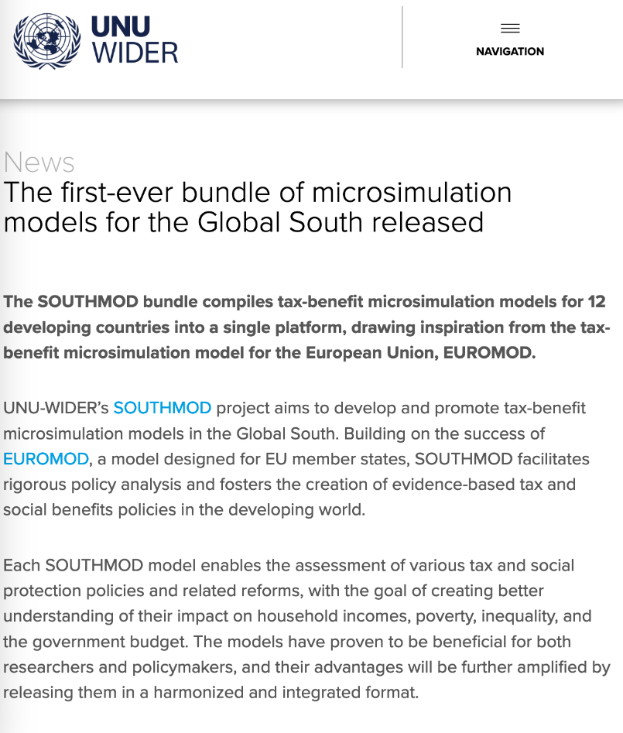
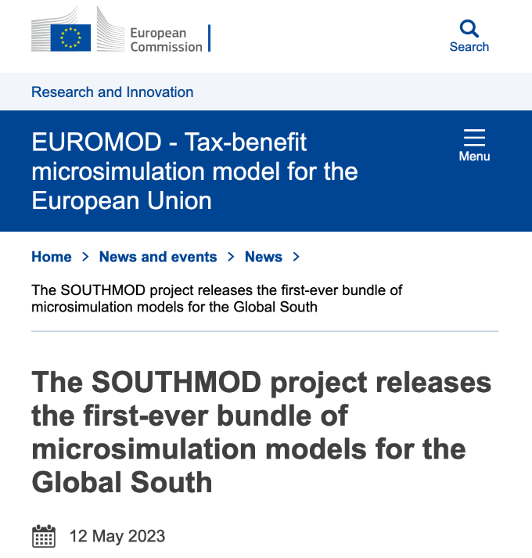
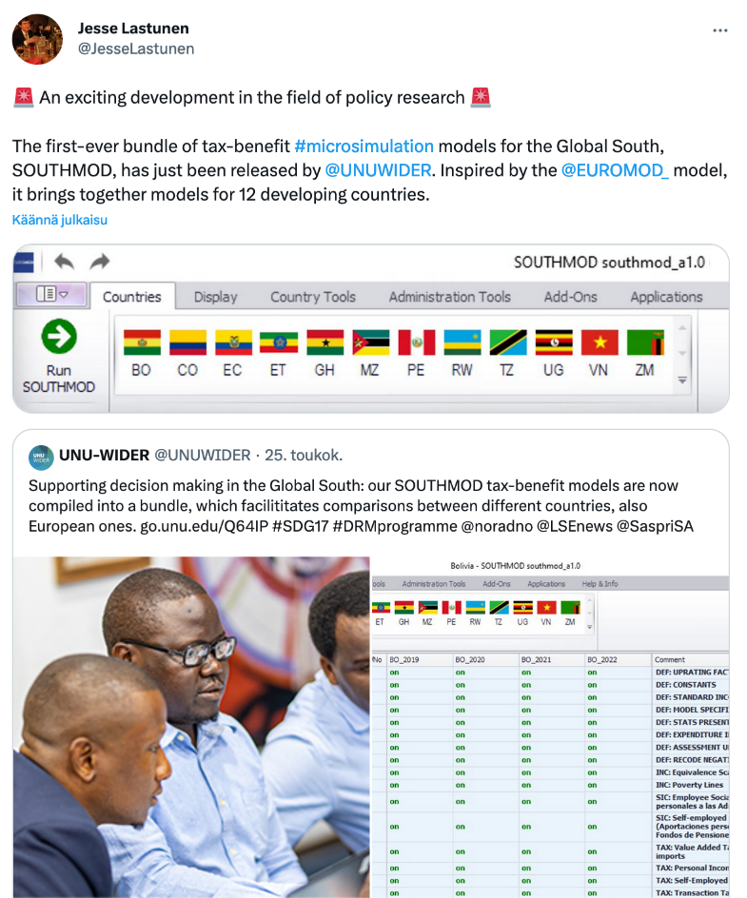
SOUTHMOD bundle: Promotion
Notes:
UNU-WIDER news article: https://www.wider.unu.edu/news/first-ever-bundle-microsimulation-models-global-south-released
JRC news article: https://euromod-web.jrc.ec.europa.eu/news-and-events/news/southmod-project-releases-first-ever-bundle-microsimulation-models-global
Oslo conference in June: https://www.wider.unu.edu/event/southmod-presentation-lotte-skatt-conference
Tweet chain: https://twitter.com/JesseLastunen/status/1661751404179120131

Slide 11
SOUTHMOD online training course in the plans
Introductory open-access training course on tax-benefit microsimulation models in a developing country context, using EUROMOD
Targeted to existing SOUTHMOD model users, including new users
English and at least Spanish translations for the videos
Ten 10-minute video classes, along with exercises (multiple-choice + modelling)
Hosted on a dedicated online platform also includes other materials, such as FAQ and links
The course uses “DEVMOD”, a synthetic tax-benefit model for an artificial country
The data distributions (e.g. the informality share) are similar to existing SOUTHMOD countries
The tax-benefit policies are also similar to those in existing models
Released late this year or early next year
Notes:
Goal to reach a much larger (and global) audience
In a format that is convenient for people to engage with around the world…
…without taking time off or needing to travel to participate.

Slide 12
Thanks! Questions or thoughts?
UNU-WIDER news article:
https://www.wider.unu.edu/news/first-ever-bundle-microsimulation-models-global-south-released
JRC news article:
https://euromod-web.jrc.ec.europa.eu/news-and-events/news/southmod-project-releases-first-ever-bundle-microsimulation-models-global
Tweet chain about the bundle:
https://twitter.com/JesseLastunen/status/1661751404179120131
About LOTTE conference presentation:
https://www.wider.unu.edu/event/southmod-presentation-lotte-skatt-conference

Slide 13
Links: SOUTHMOD bundle promotion
UNU-WIDER news article: https://www.wider.unu.edu/news/first-ever-bundle-microsimulation-models-global-south-released
JRC news article: https://euromod-web.jrc.ec.europa.eu/news-and-events/news/southmod-project-releases-first-ever-bundle-microsimulation-models-global
Tweet chain about the bundle: https://twitter.com/JesseLastunen/status/1661751404179120131
About LOTTE conference presentation: https://www.wider.unu.edu/event/southmod-presentation-lotte-skatt-conference

Slide 14
Links: SOUTHMOD General
SOUTHMOD User Manual: wider.unu.edu/sites/default/files/SOUTHMOD_UserManual_230511.pdf
SOUTHMOD Modelling Conventions: wider.unu.edu/sites/default/files/About/SOUTHMOD_Modelling_Conventions_20230428.pdf
Webpage and Country Reports: wider.unu.edu/project/southmod-simulating-tax-and-benefit-policies-development-phase-2
Model access: wider.unu.edu/about/accessing-southmod-models
Sign up for the SOUTHMOD newsletter: https://www2.wider.unu.edu/content/profile-centre-network-signup

