Slide 1
Kunal Sen, UNU-WIDER
COVID-19 and Subnational State Capacity in India

Slide 2
Lecture based on a book project by UNU-WIDER (see https://www.wider.unu.edu)
Editors: Rachel Gisselquist (Senior Research Fellow, UNU-WIDER) and Anustup Kundu (U of Helsinki) and Kunal Sen (UNU-WIDER)
Werker and Sen Deals and Development
2

Slide 3
Background and Motivation
During a crisis such as a pandemic, the state plays a crucial role in responding to address the needs of citizens and others within its borders, with respect to public health as well as socioeconomic impact.
In response to the Covid-19 pandemic, growing research attention has focused on the role and diverse capacities of national state institutions in this regard (e.g., Ang, 2020; Fukuyama, 2020; Gisselquist & Vaccaro, 2022; Mao, 2021; Patterson & Balogun, 2021).
Much less research attention has been paid in this body of work to the role of the state at the sub-national level (with some key exceptions, e.g., Basu & Mazumder, 2021; Imai, Kaicker, & Gaiha, 2021; Kujur & Goswami, 2020). However, in many countries, sub-national state institutions clearly played significant roles in pandemic response.
The book project speaks to these research gaps through focused consideration of Covid-19 impact and policy response in India, at the level of states and union territories.

Slide 4
Methodology
The book adopts a nested analysis approach, combining quantitative analysis of available data across India’s states with five in-depth state-level case studies (see Lieberman 2005).
Building on initial quantitative analysis, five states were identified for in-depth study: Bihar, Kerala, Maharashtra, Uttar Pradesh, and West Bengal.
Case studies go beyond the numbers to provide nuanced consideration of the relationship among state capacity, policy response, and pandemic outcomes.

Slide 5
The Book’s Contribution
The proposed volume offers new empirical insight into what happened during the first two waves of the pandemic across India’s states, and what this variation and experience tells us about the nature of sub-national state institutions. ‘
Pandemic response and outcomes have continued to evolve, but this early period of the pandemic offers an important snapshot into the functioning of states in crisis at all levels, in a situation of highly incomplete information.
At first glance, both in India and cross-nationally, the relationship between state capacity and Covid impact during the first waves seemed precisely the opposite of what we would expect: wealthier and generally more ‘capable’ states appeared in the official data to do worse, that is to have higher rates of Covid infection and deaths than poorer states (Gisselquist & Vaccaro, 2022).
At the cross-country level, this puzzling relationship is straightforwardly explained when other factors are taken into account that correlate both with Covid infection and state capacity, such as the age structure of the population (Gisselquist & Vaccaro, 2022).
In India, somewhat different factors appear to be at work, including in particular the quality of Covid data at the state level, especially in lower capacity states. This relationship is further investigated through the case studies.

Slide 6
Defining State Capacity - 1
Following Weber (Politics as a Vocation, 1918), the state refers to a ‘human community that (successfully) claims the monopoly of the legitimate use of physical force within a given territory’.
While the government and state to some extent overlap, the state is more than the government in power; it comprises ‘the continuous administrative, legal, bureaucratic and coercive systems that attempt not only to structure relations between civil society and public authority in a polity but also to structure many crucial relationships within civil society as well’ (Stepan 1978, xii).
Three dimensions of the state are core the analysis presented in the book project: authority to provide order and security within its borders; capacity to provide basic public services; and legitimacy in terms of popular consent for the state to govern (see Bratton and Chang (2006), Carbone and Memoli (2015), Carment and Yiagadeesen (2019), Tikuisis et al. (2015), Ziaja et al. (2019)).

Slide 7
Defining State Capacity - 2
While this approach leaves aside focused consideration of other dimensions and aspects of the state – some of which are considered in more depth in selected case chapters – in our view it also speaks broadly to core aspects highlighted in the literature. For instance, state capacity and to a lesser extent authority are closely related to what is sometimes called state effectiveness.
Mann (1984) highlights two dimensions of state power, (a) the ‘despotic’ power of state elites over civil society, which we see linked closely with state authority, and (b) ‘infrastructural’ power of the state ‘to penetrate and centrally coordinate the activities of civil society through its own infrastructure’, which has a number of overlaps with the concept of state capacity as defined here (p. 114).
Likewise, Fortin-Rittberger (2014) distinguishes between infrastructural and coercive dimensions, Savoia and Sen (2015) among military, fiscal, administrative, legal, and infrastructural dimensions, and Hanson (2018) among coercive, extractive, and administrative dimensions of the state.

Slide 8
How does State Capacity matter in the Pandemic Response? (1)
The literature on the state suggests a positive relationship between state effectiveness and pandemic outcomes, all else equal.
Links between state capacity and outcomes are the most direct: ‘higher capacity’ states should be better prepared to respond to crises than ‘low capacity’ states.
A well-functioning administrative apparatus, including in specialized sectors such as health, and staffed by competent public servants, should be better prepared in terms of preventive infrastructure, evidence-based decision making, the ability to implement administrative directives, and health care more generally.

Slide 9
How does State Capacity matter in the Pandemic Response? (2)
State authority can also be expected to contribute to better outcomes given stronger ability (e.g. by the police and health officials) to enforce order and rules designed to support public health effectively and in a rule-based manner.
Examples of such rules include both lockdowns and other restrictions on social gatherings aimed to dampen the spread of the virus.
Finally, state legitimacy may impact pandemic outcomes through influence on the state’s ability to enforce rules and provide services, counting on the voluntary compliance of the population, without the costs of assertive enforcement.

Slide 10
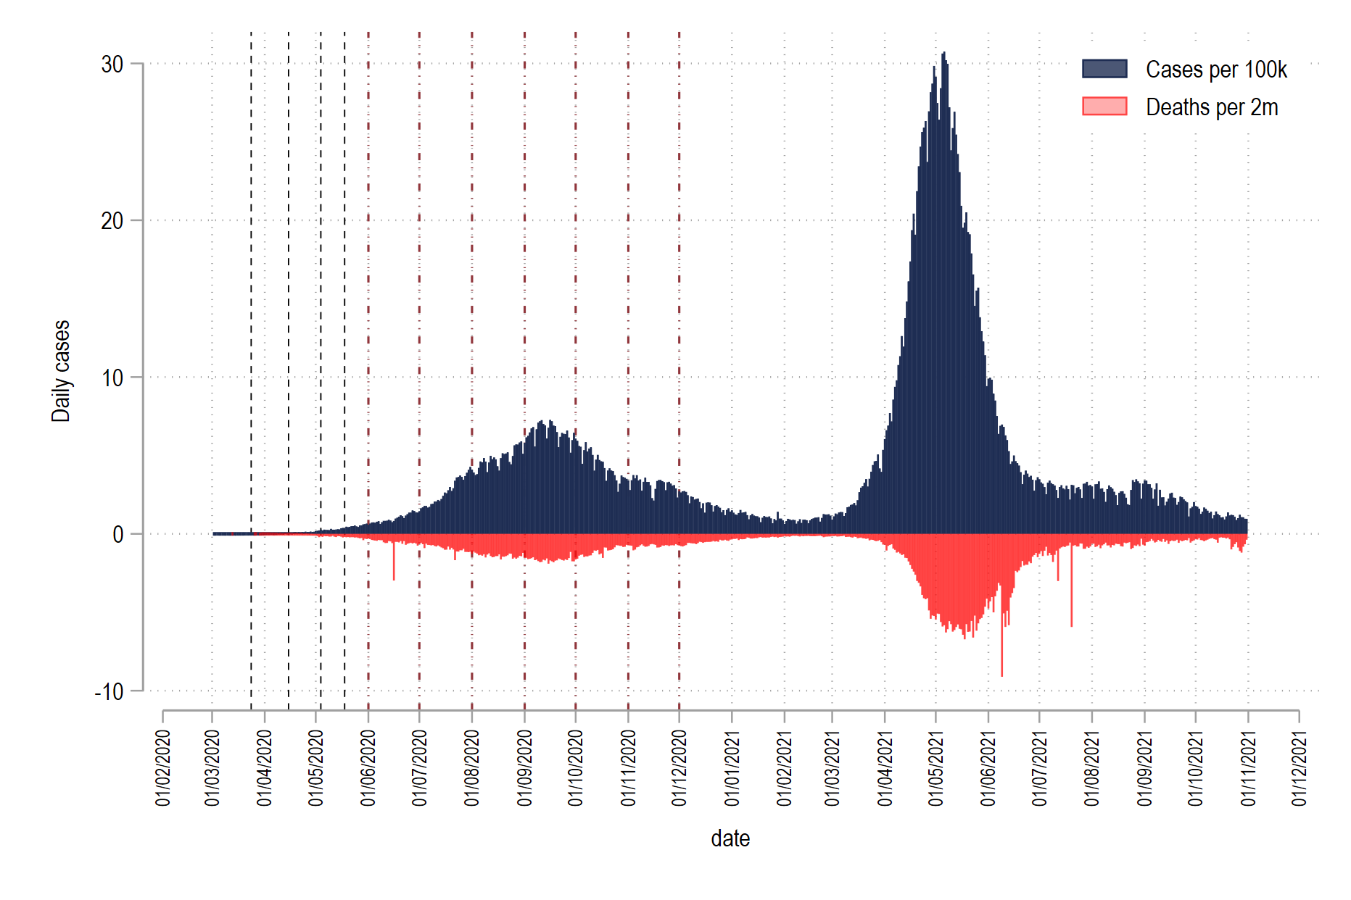
The trajectory of COVID-19 in India

Slide 11
The First COVID-19 Wave in India

Slide 12
The Second COVID-19 Wave in India

Slide 15
Case-Selection of Indian States
state | Log GSDP PC CASES CASES 100K Deaths Deaths 100K CFR
-------------+------------------------------------------------------------------
Bihar | 10.44619 726090 598.5804 9661 7.964419 1.330551
Kerala | 12.00283 4961490 14052.43 31514 89.25709 .6351721
Maharashtra | 12.06541 6609906 5361.05 140196 113.7078 2.120998
Uttar_Prad~h | 10.84457 1710152 750.2542 22900 10.04637 1.339062
West_Bengal | 11.28714 1591994 1632.546 19126 19.61319 1.201386
-------------+------------------------------------------------------------------

Slide 16
COVID-19 Cases/Deaths and State Capacity (DAGI, from Mundle et al. EPW)

Slide 17
Bihar – Avinash Kumar (JNU) and Manish Kumar (U of Delhi)
Poor level of health preparedness pre-COVID (26 doctors per million persons compared to all India average of 90). Shortfall in curative and preventive health facilities second largest after UP.
State performed poorly in NPIs.
Massive under-counting of COVID cases and deaths “to suit political interests”

Slide 18
Kerala – Jos Chathukulam and Manasi Joseph (CRM, Kerala)
While the Kerala model of managing the pandemic was celebrated during the first wave, the state was significantly more affected in the second wave, raising questions about the Kerala model.
The authors argue that the state’s biggest advantages in pandemic response were its robust healthcare system and participatory mode of governance.
This in turn created a sort of performance legitimacy for the LDF government.
However, even in this context, clientelism and competitive and adversarial politics influenced pandemic management, with major health consequences.

Slide 19
Maharashtra – Manish K. Jha (TISS, Mumbai)
Socio-economic and spatial-demographic context are important in understanding why and the severity of the pandemic in Maharashtra.
But the situation was also dynamic: the state over time improved its response, from a situation of confusion to an augmentation of infrastructure and a coordinated response.
The Mumbai, Dharavi and Nandurbar Models – emphasis on planning, decentralization and delegation in effective pandemic response.
Local leadership also mattered as also context specific responses.
Problematic centre-state relations (e.g. the National Disaster Response Fund).

Slide 20
Uttar Pradesh – Indrajit Roy (U. of York)
Pandemic’s impact far worse than reported in official statistics.
To understand the state’s response, Roy argues that one needs to examine the evolution of the social foundations of state capacity in UP since Independence.
From an elitist social coalition till 1989, to an inclusive social coalition till 2017, and more recently, to an ethnic social coalition.
Human development outcomes improved under the inclusive social coalition.
But the state’s majoritarian turn recently led to large-scale Hindu religious festivals being held, which possibly led to rapid spread of the virus.

Slide 21
West Bengal – Zaad Mahmood (Presidency College, Kolkata) and Achin Chakraborty (IDS, Kolkata)
The authors argue that the relationship between conventional measures of state capacity and pandemic response and outcomes in West Bengal is ambiguous.
They suggest that this is due to the dynamic nature of state capacity.
The three components of state capacity – authority, capacity and legitimacy – show significant variation during the pandemic response.
Their analysis illustrates both varying government effectiveness in testing and containment due to policy interventions and infrastructural limitations, and varying legitimacy - increasing during the initial phase of the pandemic and subsequently undermined by populist pressures, limited fiscal and institutional capacity, and centralized decision processes.

Slide 22
Main Findings -1
Four points emerge from a collective reading of the analysis presented in this volume.
The first point, consistent with other work, is the significance of state capacity in understanding the varying quality of pandemic responses. At a basic level, states with comparatively lower capacity and resources were comparatively less able to respond to health needs and to shield populations from socioeconomic impacts.
The fact of Kerala’s comparatively robust healthcare system, for instance, is important in understanding the state’s early comparative success in managing the pandemic compared with the other states.
Second, however, simple static indicators of state capacity alone tell us little about the considerable variation over time in the quality of pandemic response within states. Mahmood and Chakraborty’s chapter makes this argument explicitly, but it is also clear in other studies.
In particular, the case studies of the ’high’ capacity states Kerala and Maharashtra illustrate this point well, showing significant change over time in the quality of state pandemic response and outcomes - that does not map to any simple measure variation in state capacity.

Slide 23
Main Findings -2
Third, there are clear problems with Covid statistics which bias analysis in significant ways. In particular, undercounting of cases and deaths may be more of a problem in poorer, lower capacity states - as Kumar and Kumar suggest in their analysis of the Bihar experience.
The problems with Covid statistics seem to stem both from lack of capacity to collect better statistics in some contexts, as well as purposive action by governments to undercount or otherwise manipulate the numbers for political purposes - as Kumar and Kumar show. Poor statistics in turn have impact on the quality of evidence-based pandemic response.
Fourth, even more than state capacity alone, the interaction between state capacity and government legitimacy may shed light on the different quality of pandemic responses. Electoral considerations by governments are mentioned in almost all chapters as influencing pandemic response alongside public health and economic considerations.

Slide 24
Main Findings -3
Even in Kerala, Chathukulam and Joseph’s analysis suggests, competitive politics influenced pandemic management.
Yet the ability of the Bihar government to influence data collection as a means of shoring up political legitimacy arguably was of a different scale in part because its weaker state institutions were less able to constrain such manipulation. Likewise, both chapters point to some level of performance legitimacy for the state government - given the real or manipulated picture of successful pandemic management during the first wave.
Roy’s chapter on Uttar Pradesh highlights yet another angle to this relationship between capacity and legitimacy, pointing to the UP state government’s efforts to build legitimacy through its ideological commitment to ethnic social coalition - possibly to the detriment of socioeconomic considerations and sound pandemic management.

Slide 25
To Conclude
Our analysis illustrates the central importance of state capacity on pandemic response in two ways.
The first is straightforward: differences in levels of capacity imply differences in terms of public health preparedness, ability to test and treat cases, and adequacy of safety net programmes; states with comparatively lower capacity in general were, as expected, less prepared, less able to respond to health needs, and less able to shield populations from socioeconomic impacts.
The second is a more complex interaction, of state capacity on evidence based policymaking. Political calculus, alongside public health and economic considerations, both figure in how governments across India – and around the world - responded to the pandemic, but state capacity influenced the balance.
One simple implication of this is to underscore the importance of continued attention to the role of accountable public institutions at all levels in building resilience and preparedness for future crises.

